Slide 1


Slide 2
Discipleship & evangelism
ACCFS Discipleship Conference
Tremont, IL 4/20/24
Notes:
How does discipleship relate to evangelism? In this breakout, a HarvestCall leader will help us gain a clearer understanding of how discipleship serves as the cornerstone for effective evangelism. The session will provide valuable guidance on practicing a holistic approach to evangelistic efforts that lead others into living as committed disciples of Jesus.

Slide 3

Scriptures
Matthew 28:18-20
Mark 16:14-18
Luke 24:45-49
John 20:19-23
Acts 1:8
Notes:
Read 1 passage at a time.
Write all observations on a flip chart

Slide 4
Matthew 28:18-20
And Jesus came and said to them, “All authority in heaven and on earth has been given to me. [19] Go therefore and make disciples of all nations, baptizing them in the name of the Father and of the Son and of the Holy Spirit, [20] teaching them to observe all that I have commanded you. And behold, I am with you always, to the end of the age.”

Slide 5
Mark 16:14-18
Afterward he appeared to the eleven themselves as they were reclining at table, and he rebuked them for their unbelief and hardness of heart, because they had not believed those who saw him after he had risen. [15] And he said to them, “Go into all the world and proclaim the gospel to the whole creation. [16] Whoever believes and is baptized will be saved, but whoever does not believe will be condemned. [17] And these signs will accompany those who believe: in my name they will cast out demons; they will speak in new tongues; [18] they will pick up serpents with their hands; and if they drink any deadly poison, it will not hurt them; they will lay their hands on the sick, and they will recover.”

Slide 6
Luke 24:45-49
Then he opened their minds to understand the Scriptures, [46] and said to them, “Thus it is written, that the Christ should suffer and on the third day rise from the dead, [47] and that repentance for the forgiveness of sins should be proclaimed in his name to all nations, beginning from Jerusalem. [48] You are witnesses of these things. [49] And behold, I am sending the promise of my Father upon you. But stay in the city until you are clothed with power from on high.”

Slide 7
John 20:19-23
On the evening of that day, the first day of the week, the doors being locked where the disciples were for fear of the Jews, Jesus came and stood among them and said to them, “Peace be with you.” [20] When he had said this, he showed them his hands and his side. Then the disciples were glad when they saw the Lord. [21] Jesus said to them again, “Peace be with you. As the Father has sent me, even so I am sending you.” [22] And when he had said this, he breathed on them and said to them, “Receive the Holy Spirit. [23] If you forgive the sins of any, they are forgiven them; if you withhold forgiveness from any, it is withheld.”

Slide 8
Acts 1:8
He said to them, “It is not for you to know times or seasons that the Father has fixed by his own authority. [8] But you will receive power when the Holy Spirit has come upon you, and you will be my witnesses in Jerusalem and in all Judea and Samaria, and to the end of the earth.”

Slide 9
Summary Statement
God desires the church through the power of the Spirit to engage in making committed disciples to Jesus Christ among all nations until the end of the age.
Notes:
Who – the church
What – make disciples
Where – all nations
When – until the end of the age
Why –
How – through the power of the Spirit

Slide 10
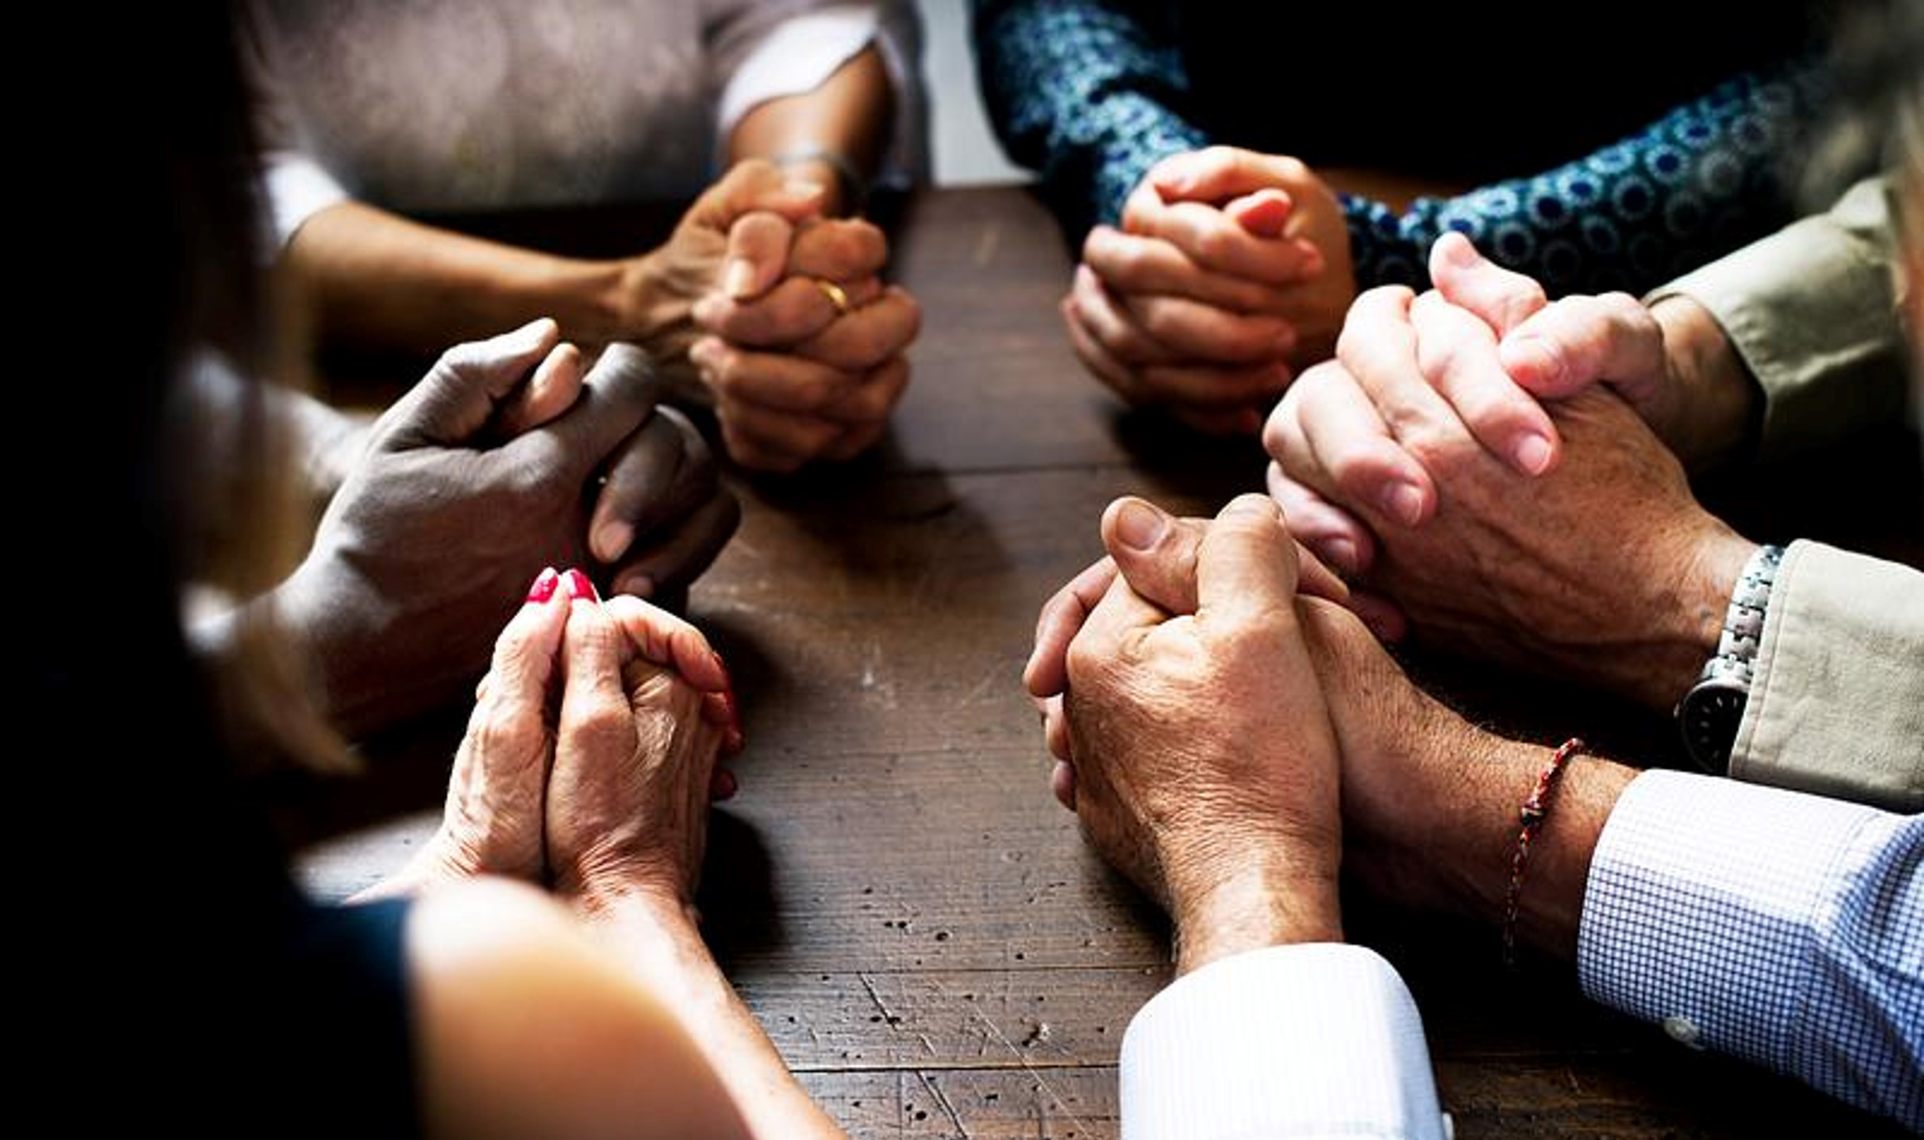
WHO - The Church
Notes:
Definition of Church
Believers in Christ
Shalom
Sins remitted
Gathering regularly
Biblical Purposes
Recognized spiritual leadership
None of Commissions state church. They are all given to the 11 or the 10.
However, they did say:
Remit & retain sins (similar to Matthew 18)
Baptize – role of the church.
Given to 12 – can be transferred to the church.
How did they fulfill commission:
Preach
Gathered to churches
Leadership set up in churches
Letters to churches
Letters to pastors
Re-visited churches on missionary journey
Revelation 2 & 3 – to churches
Church declared – pillar & ground of truth.

Slide 11

WHAT – Make Disciples

Slide 12
WHERE – All Nations

Slide 13

WHEN – UNTIL THE END OF THE AGE

Slide 14
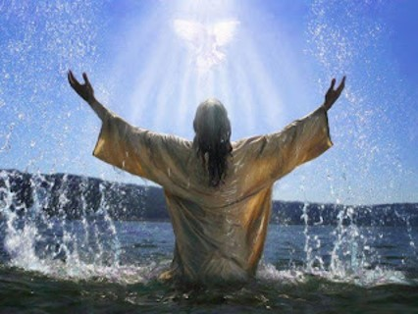
HOW – Power of the Spirit

Slide 15
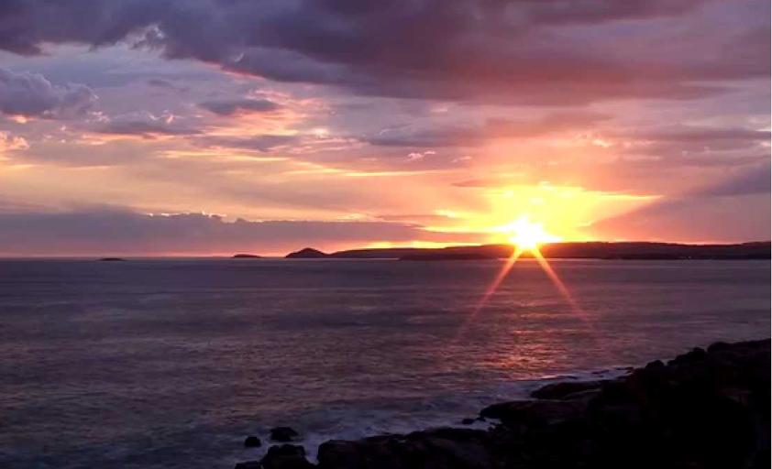
WHY – The Glory of God

Slide 16
Summary Statement
God desires the church through the power of the Spirit to engage in making committed disciples to Jesus Christ among all nations until the end of the age.
Notes:
Who – the church
What – make disciples
Where – all nations
When – until the end of the age
Why –
How – through the power of the Spirit

Slide 17

Evangelism or Discipleship
Notes:
Are the Commissions about evangelism or discipleship?
Examples
Blood Pressure Cuff & Stethoscope.
Combine or Head.

Slide 18
Evangelism & Discipleship Connection
Characteristics of Discipleship
Become a Disciple
Grow as a Disciple
Grow Together as Disciples
Proclaim the Gospel to Make Disciples
Teach Disciples
Notes:
Become a disciple
All men are either disciples or not.
You are either
Lost or saved
Dead or alive
In Christ or Out of Christ
Enemies of God, friends of God.
One way to become a disciple – choose to follow God through faith in Jesus Christ
Often referred to as evangelism
Grow as Disciple
That is what much of this conference is about.
How do we grow to know, obey, and honor our Lord and Savior Jesus Christ?
This occurs through what has been taught today
Spiritual Transformation - The process of the Holy Spirit, with our cooperation, bringing us into a deeper relationship with God and conforming us to be more like Jesus.
Occurs through spiritual disciplines as we come to know God.
Reading, prayer, fasting, Sabbathing, etc.
Grow Together as Disciples
Not just us and God
Church Central to growth
Unity and learning to communicate through differences
Growing through the roles given.
One another’s in scriptures.
Love one another
Encourage one another
Exhort another
Provoke one another
Bear one another’s burdens
Etc.
Proclaim the Gospel and Make Disciples
If Christ is precious, share him with others.
Growing in knowing Christ and not being a disciple maker = no sense!
Normal in Acts – those that know God share Christ!
Randy Mogler on this topic – you are constipated!
Teach Disciples
Mentoring and discipling
How to:
Fast
Study scripture
Love your wife
Pray
Interact with your neighbor.
Share Christ with others.
Answer Hard questions.
Rejoice in trial.
Etc.
Examples of this
Paul & Timothy
Barnabas and John Mark
Paul & Silas
END GOAL – Reproduction/Multiplication! Disciples Make Disciples who make disciples.

Slide 19
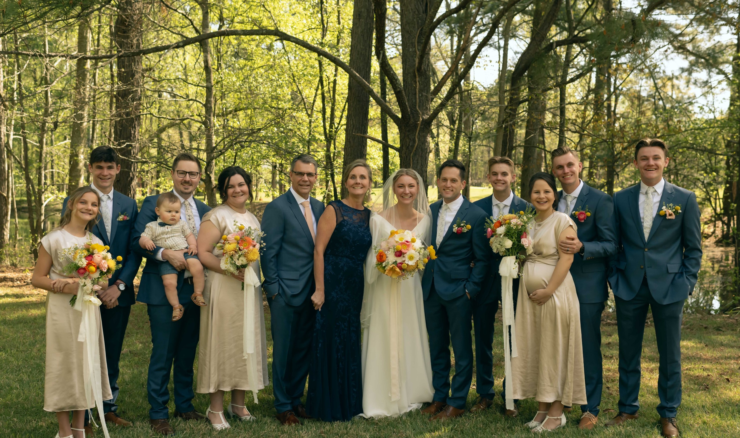
My Testimony
Become a Disciple
Grow as a Disciple
Grow Together as Disciples
Make Disciples
Teach Disciples
Notes:
Become
Parents. Linn Stoller, Shawn Hari, Mark Streitmatter.
November 22nd 1992 – I BECAME A DISCIPLE.
Baptized at age 18
Grow
Habits of Reading and studying scripture – increased at 25
Gospel breakthrough at 26
What does it say, what does it mean, how does it apply.
Memorization, fasting, prayer, last year learning sabbathing, etc.
Grow Together
Mentored by others
Young years – Denny Kaufmann, Mark Streitmatter.
Middle years – Kent Kloter
Recent Years – Pete Welti, Nick Gutwein, John Wiegand, Ron Messner
Bible study groups
Marriage
Parenting
Men’s studies
4 churches
Chicago – Darin Metzger, Lenny & Charlotte Myer
Bloomington – Sunday School, building lasting relationships
Fairbury – Secretary, Sunday School brothers & Sisters, difficult conversations.
Peachtree City – Ministry, involvement with young men and couples
Make Disciples
Early Years – clumsy and difficult
Philosophy class in College
Paul W.
Middle Years
Bible Class in Fairbury
Sharing as PT
Children – I have watched all 7 become disciples
Dana’s Brother – that is really good news
Mr. Larry, Keith Lau, Manna
Teach Disciples
Preaching
Discipling Young Men
Discipling My Children
Engaging with New Disciples – Wes
Engaging with Missionaries – Ryan Steffen
Part of Discipling – teaching others to make disciples.
Story of Micah with Manna
I have no greater joy than to see my children walk in truth.

Slide 20
Evangelism or Discipleship
Notes:
Is my life about evangelism or discipleship?
Is my Life about all nations?

Slide 21

ALL NATIONS
Notes:
We have stated that God desires this to happen in all nations until the end of the age.
How do we reconcile what we have been discussing with all nations?
Does my testimony include all nations?
We need to address this.

Slide 22
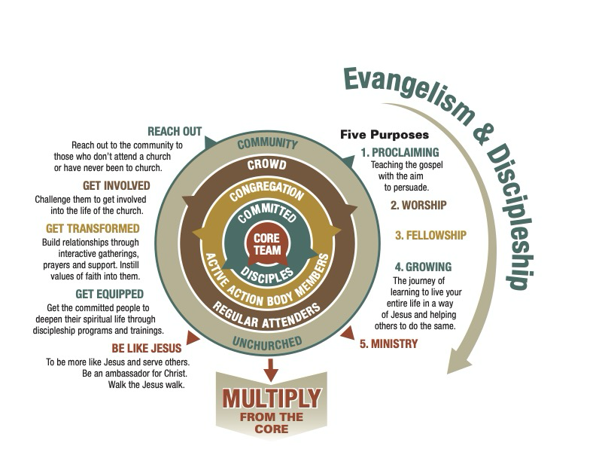
Notes:
Goal – to increase the CORE of the Church for the purpose of multiplication.
Ministers/Pastors
Ephesians 4 – equip your church for the work of ministry!
Need less pastoral “working” and more pastoral “equipping”.
If you have a genuinely strong CORE, you should anticipate multiplication.
More people at the CORE entering the “messiness” of ministry.
The goal of the church is the following:
Congregation
Committed
Core
As the Core grows, multiplication should be in mind – HERE AND THERE!
Disciples are reproducing disciples.
Some stay, some go, ALL are focused on multiplication!

Slide 23
Summary Statement
God desires the church through the power of the Spirit to engage in making committed disciples to Jesus Christ among all nations until the end of the age.
Notes:
Who – the church
What – make disciples
Where – all nations
When – until the end of the age
Why –
How – through the power of the Spirit

Slide 24
Meditation Questions
Have you become a disciple of Jesus?
How are you growing as a disciple of Jesus?
How are you growing together in your church as a disciple of Jesus?
How are you proclaiming the gospel and making disciples of Jesus?
How are you teaching disciples of Jesus?
How is your church engaged in discipleship in all nations?

Slide 25
questions
Notes:
How does discipleship relate to evangelism? In this breakout, a HarvestCall leader will help us gain a clearer understanding of how discipleship serves as the cornerstone for effective evangelism. The session will provide valuable guidance on practicing a holistic approach to evangelistic efforts that lead others into living as committed disciples of Jesus.

